Slide 1
Lesson 3: Exploring and Validating Data
3.1 Exploring Data
3.2 Filtering Rows
3.3 Formatting Columns
3.4 Sorting Data and Removing Duplicates

Slide 2
Lesson 3: Exploring and Validating Data
3.1 Exploring Data
3.2 Filtering Rows
3.3 Formatting Columns
3.4 Sorting Data and Removing Duplicates

Slide 3
SAS Programming Process
Access data
Explore data
Prepare data
Analyze and report on data
Export results
$w.
w.d
Notes:
Now that we know how to access data, we need to explore it a little and see what we have to work with. Exploring data can include learning about the columns and values we have, as well as validating data to look for incorrect or inconsistent values. In this lesson, you learn to use some procedures that give you some of this insight. You also learn to subset the data so you can focus on particular segments, format data so you can easily understand it, sort data, and identify and clean up duplicate values.

Slide 4
Exploring Data with Procedures
PRINT
MEANS
UNIVARIATE
FREQ
Notes:
After you are able to access your data, the next step is to make sure you understand it. Certainly just looking over the table is helpful, and PROC CONTENTS enables you to confirm column attributes, but often the data is too large or complex for a visual review to be sufficient.
SAS has several procedures that can be used to quickly and easily explore your data. Later we use some of these same procedures with additional options to analyze and report on data.

Slide 5
PRINT Procedure
PROC PRINT DATA=input-table (OBS=n);
RUN;
use to specify the last observation (row) to read
By default, PROC PRINT lists all columns and rows in the input table.
p103d01
Notes:
By default, the PRINT procedure lists all columns and rows in the input table. To limit the number of rows listed, especially if it's a large table, you can use the OBS= data set option in parentheses after the table name.

Slide 6
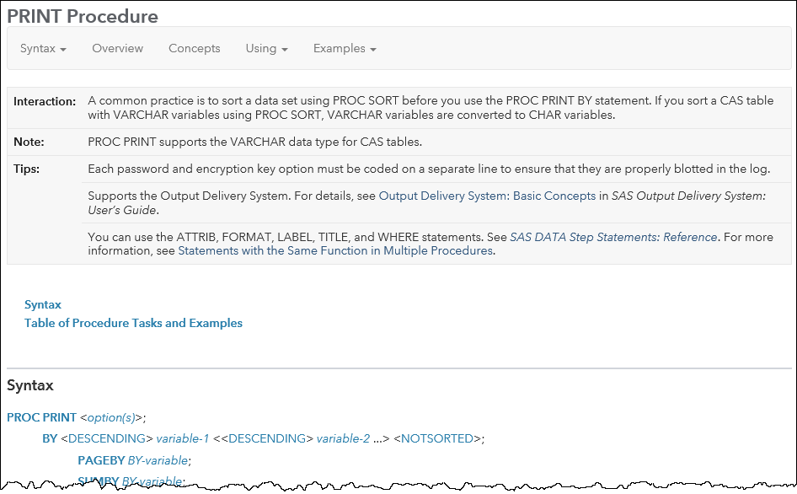
Setup for the Question
Go to support.sas.com/documentation. Click Programming: SAS 9.4 and Viya.
Under Syntax - Quick Links, click By Name in the Procedures group and find PRINT. Examine the syntax and the table of procedure tasks and examples.

Slide 7
3.01 Multiple Choice Question
Which statement in PROC PRINT selects variables that appear in the report and determines their order?
BY
ID
SUM
VAR
Notes:
Type answer here

Slide 8
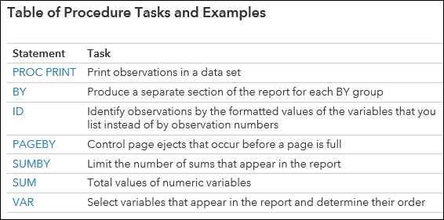
3.01 Multiple Choice Question – Correct Answer
Which statement in PROC PRINT selects variables that appear in the report and determines their order?
BY
ID
SUM
VAR
Notes:
Type answer here

Slide 9
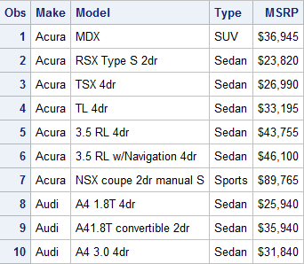
PRINT Procedure
proc print data=sashelp.cars (obs=10);
var Make Model Type MSRP;
run;
p103d01
Notes:
This PROC PRINT step lists the first 10 rows, or observations, from the sashelp.cars table and displays only the Make, Model, Type, and MSRP columns.

Slide 10
MEANS Procedure
PROC MEANS DATA=input-table;
VAR col-name(s);
RUN;
By default, PROC MEANS generates simple summary statistics for each numeric column in the input data.
use to specify the numeric columns to analyze
p103d01
Notes:
The MEANS procedure generates simple summary statistics for each numeric column in the input data. You can use the VAR statement to limit the columns, or variables, that SAS analyzes.

Slide 11
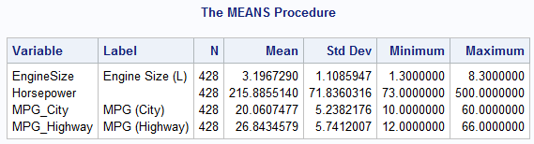
MEANS Procedure
proc means data=sashelp.cars;
var EngineSize Horsepower MPG_City MPG_Highway;
run;
p103d01
Notes:
This PROC MEANS step calculates the default statistics – frequency count (N), mean, standard deviation, minimum, and maximum – for each of the columns that is listed in the VAR statement.
By examining the PROC MEANS results, you can identify average values, or values that might be outside of an expected range.

Slide 12
UNIVARIATE Procedure
PROC UNIVARIATE DATA=input-table;
VAR col-name(s);
RUN;
By default, PROC UNIVARIATE generates summary statistics for each numeric column in the input data.
use to specify the numeric columns to analyze
p103d01
Notes:
The UNIVARIATE procedure also generates summary statistics, but it includes more detailed statistics related to distribution and extreme values. Notice that it also uses a VAR statement like PROC PRINT and PROC MEANS to select the columns to analyze.

Slide 13
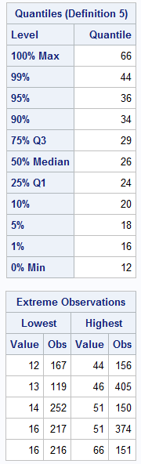
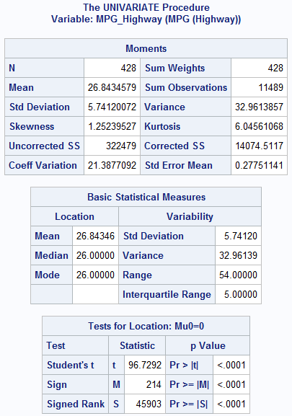
UNIVARIATE Procedure
proc univariate data=sashelp.cars;
var MPG_Highway;
run;
p103d01
Notes:
This PROC UNIVARIATE step analyzes MPG_Highway and provides several summary statistics, including the five lowest and highest extreme values and their observation numbers.

Slide 14
FREQ Procedure
PROC FREQ DATA=input-table;
TABLES col-name(s);
RUN;
By default, PROC FREQ creates a frequency table for each column in the input table.
use to specify the frequency tables to include in the results
p103d01
Notes:
The FREQ procedure creates a frequency table for each column in the input table by default, or you can use the TABLES statement to limit the columns that SAS analyzes.

Slide 15
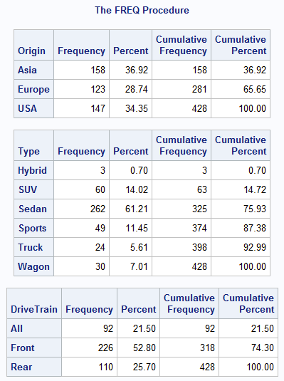
FREQ Procedure
proc freq data=sashelp.cars;
tables Origin Type DriveTrain;
run;
p103d01
Notes:
This PROC FREQ step creates a separate table for Origin, Type, and DriveTrain. Each table includes a list of the distinct values for the column along with a frequency count, percent, and cumulative frequency and percent. This is a great way to validate the data in your columns. For example, you might notice unexpected values or values that appear in both uppercase and lowercase.

Slide 16
Exploring Data with SAS Procedures
This demonstration illustrates using the PRINT, FREQ, MEANS, and UNIVARIATE procedures to explore and validate data.
p103d01
Notes:
Let’s first try out these four procedures to learn more about the STORM_SUMMARY table. We’ll start with the default PROC PRINT for PG1.STORM_SUMMARY. PROC PRINT creates a listing report that by default, includes all the rows and columns from the input table, plus an additional column labeled OBS. If I would like to either limit the columns printed, or change the order they appear in the listing report, I can add a VAR statement and list the columns in the order I would like them displayed. I will start with Date, Name, Basin, Status, MaxWindMPH and MinPressure. Enterprise Guide makes populating this statement easy with the Autocomplete feature displaying the column names from the STORM_SUMMARY table. In SAS Studio, you can take advantage of the Library section to access the table and select columns to drag and drop into the VAR statement.
Unless your table is fairly small, you usually only want to use PROC PRINT to list a subset of the rows. An easy way to limit the output to a fixed number of rows is use the OBS= data set option. Data set options are listed immediately after the table name in parentheses. So right after PG1.STORM_SUMMARY, I can add the OBS=10 option to just print the first 10 rows. Later we will discuss filtering the rows in PROC PRINT and other procedures with a condition.
proc print data=pg1.storm_summary(obs=10);
var Date Name Basin Status MaxWindMPH MinPressure Flag;
run;
Next let’s try my favorite procedure, PROC FREQ. I’ll start with the same basic syntax we’ve seen with PROC CONTENTS and PROC PRINT. After running this basic program, notice my output is quite extensive. It includes a separate table for each column in my data. Each table lists the distinct values, and the frequency count and percentage that each value represents in the data. Some of these tables are more useful than others. If I would like to limit the tables included in the results, I can add a TABLES statement. For the STORM_SUMMARY data set, I would like to see frequency tables for basin, flag and status. These frequency tables are incredibly useful for many reasons. You can start to look at the basic distribution of your data values. You can observe problems in the data, like miscoded values or case inconsistencies. Notice Basin is mostly upper case values, but we have 2 rows where Basin is lower case al.
proc freq data=pg1. storm_summary;
tables basin Flag Status;
run;
How about another procedure? PROC MEANS is a great way to look as basic summary statistics for our numeric columns. If I start with the PROC MEANS statement only, the output includes a row for each numeric column in the data, and 5 summary statistics, including N (or number of non-missing values), mean or average, standard deviation, minimum and maximum. Remember Date is numeric, so it is included in this report. If I would like to limit the variables analyzed, I can add a VAR statement and list just MaxWindMPH and MinPressure. We can see from just a quick glance at this report that we have over 500 rows with missing values for MinPressure. We can also get an idea of the ranges for these columns, and if there may be values that are invalid because they are larger or smaller than possible.
proc means data=pg1. storm_summary;
var MaxWindMPH MinPressure;
run;
One other procedure I will mention is PROC UNIVARIATE. I will just change the word MEANS to UNIVARIATE, leave the VAR statement and run the step. This give a slightly deeper statistical look at both MaxWindMPH and MinPressure. I won’t describe all of the numbers reported, but one part of the output I would like to highlight is the Extreme Observations table. Here we see the lowest and highest 5 values.
proc univariate data=pg1. storm_summary;
var MaxWindMPH MinPressure;
run;
We have just scratched the surface with what these procedures can do, but you can see by simply changing the PROC name in your code, SAS quickly creates useful output that you can use to better understand your data.

Slide 17
Practice
This practice reinforces the concepts discussed previously.

Slide 18
Lesson 3: Exploring and Validating Data
3.1 Exploring Data
3.2 Filtering Rows
3.3 Formatting Columns
3.4 Sorting Data and Removing Duplicates

Slide 19
Filtering Rows with the WHERE Statement
PROC procedure-name . . . ;
WHERE expression;
RUN;
filters rows in the results based on the expression
If expression is true, include the row in the results.
Notes:
What if you want to filter the rows that appear in a PROC PRINT report? Or what if you only want to calculate summary statistics for a subset of the data based on a condition? You can use the powerful and flexible WHERE statement to subset your data. The WHERE statement can be used in PROC PRINT, MEANS, FREQ, UNIVARIATE and many others.

Slide 20
Using Basic Operators in an Expression
WHERE expression;
column
operator
value
= or EQ
< or LT
Type = "SUV"
Type EQ "SUV"
^= or ~= or NE
>= or GE
MSRP <= 30000
> or GT
<= or LE
MSRP LE 30000
Notes:
The WHERE statement consists of the keyword WHERE followed by one or more expressions. An expression tests the value of a column against a condition that you specify.
First, let's look at expressions that use basic operators. We can use any of these operators to compare the value of a column to a value that you specify. The expression evaluates as true or false for each row. You can use either the symbol or letters to represent these operators in an expression.

Slide 21
Specifying Values in an Expression
WHERE expression;
column
operator
value
Type = "SUV"
Character values are case sensitive and must be enclosed in double or single quotation marks.
Type = 'Wagon'
MSRP <= 30000
Numeric values must be standard numeric (that is, no symbols).
Notes:
Character values are case sensitive and must be enclosed in double or single quotation marks. Numeric values are not enclosed in quotation marks and must be standard numeric values. In other words, you cannot include special symbols such as commas or dollar signs.

Slide 22
Specifying Values in an Expression
WHERE expression;
column
operator
value
Use a SAS date constant when you want to evaluate a SAS date value in an expression.
"ddmmmyyyy"d
where date > "01JAN2015"d;
where date > "1jan15"d;
Notes:
What about comparing the value of a column to a date? Remember that dates are stored as numeric values, so the expression is evaluated based on a numeric comparison. If you want to compare a date column to a fixed date, then you can use the SAS date constant notation. Type the date as a one- or two-digit day, a three-letter month, and two- or four-digit year, enclosed in quotation marks, followed by the letter D. SAS then turns the string date into the numeric equivalent in order to evaluate the expression.

Slide 23
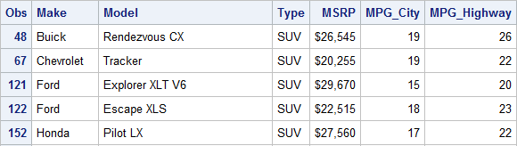
Combining Expressions
proc print data=sashelp.cars;
var Make Model Type MSRP MPG_City MPG_Highway;
where Type="SUV" and MSRP <= 30000;
run;
Expressions can be combined with AND or OR.
p103d02
Notes:
You can also combine multiple expressions with the keywords AND or OR. In this example code, any rows that meet theses two conditions are included in the PROC PRINT results.

Slide 24
Using the IN Operator
Values can be character or numeric.
WHERE col-name IN (value-1,…,value-n);
WHERE col-name NOT IN (value-1,…,value-n);
where Type="SUV" or Type="Truck" or Type="Wagon";
where Type in ("SUV","Truck","Wagon");
All three of these statements have the same result.
where Type in ("SUV" "Truck" "Wagon");
Notes:
We've only begun to learn the ways you can use the WHERE statement to subset rows in a procedure. Let’s look at several other examples of operators that enable you to do more complex filtering.
We’ve seen how the OR keyword can be used to provide multiple values, such as in this example. Notice that each condition has to include TYPE=. This can be tedious if there are several valid values that you would like to include. A more efficient approach in this scenario is to use the IN operator to compare to a list of values.
After typing the column name, we use the keyword IN, and in parentheses, list the values separated by commas or spaces. The IN operator works with both numeric and character values. Just keep in mind that character values are case sensitive and must be enclosed in quotation marks. We can also take advantage of the keyword NOT to reverse the logic of the IN operator.

Slide 25
Filtering Rows with Basic Operators
This demonstration illustrates using the WHERE statement and basic operators to subset rows in a procedure.
p103d02

Slide 26
Using Special WHERE Operators
WHERE col-name IS MISSING;
WHERE col-name IS NOT MISSING;
These operators work for both character and numeric missing values.
where age is missing;
where name is not missing;
Notes:
Let's talk about some special WHERE operators that you can use in expressions. Suppose you want to filter your data by missing values. You could write an expression where a column is equal to a period for numeric missing values or a space enclosed in quotation marks for a character missing value, but a simpler option is to use the IS MISSING or IS NOT MISSING special operator. These keywords can be used for either numeric or character missing values.
And if you happen to be working with data coming from a DBMS environment that distinguishes between missing and null values, then there is also an IS NULL operator.

Slide 27
Using Special WHERE Operators
WHERE col-name BETWEEN value-1 AND value-2;
where age between 20 and 39;
For character values, the range is based on the alphabet.
includes rows with values between and including the endpoints that you specify
Notes:
The BETWEEN AND operator is handy for numeric and character ranges. The endpoints of the range are inclusive.

Slide 28
Using Special WHERE Operators
WHERE col-name LIKE "value";
where City like "New%";
where City like "Sant_ %";
New York
New Delhi
Newport
Newcastle
New
Santa Clara
Santa Cruz
Santo Domingo
Santo Tomas
wildcard for any number of characters
wildcard for a single character
Notes:
Finally, the LIKE operator enables us to do pattern matching. The percent symbol is a wildcard for any number of characters and the underscore is a wildcard for a single character.

Slide 29
3.02 Activity
Open p103a02.sas from the activities folder and perform the following tasks:
Uncomment each WHERE statement one at a time and run the step to observe the rows that are included in the results.
Comment all previous WHERE statements. Add a new WHERE statement to print storms that begin with Z. How many storms are included in the results?
Notes:
Type answer here

Slide 30
3.02 Activity – Correct Answer
Add a new WHERE statement to print storms that begin with Z. How many storms are included?
proc print data=pg1.storm_summary(obs=50);
commented where statements
where name like "Z%";
run;
NOTE: There were 24 observations read from the data set PG1.STORM_SUMMARY.
WHERE name like 'Z%';
Notes:
Type answer here

Slide 31

Efficiently Changing the Filter Value
proc print data=sashelp.cars;
where Type="Wagon";
var Type Make Model MSRP;
run;
proc means data=sashelp.cars;
where Type="Wagon";
var MSRP MPG_Highway;
run;
proc freq data=sashelp.cars;
where Type="Wagon"; tables Origin Make;
run;
proc print data=sashelp.cars;
where Type="SUV";
var Type Make Model MSRP;
run;
proc means data=sashelp.cars;
where Type="SUV";
var MSRP MPG_Highway;
run;
proc freq data=sashelp.cars; where Type="SUV";
tables Origin Make;
run;
Wagon ⇨ SUV
How can you easily replace this value everywhere in the program?
Notes:
Suppose you have a program with multiple procedures, and you want to filter in each procedure to select only rows where the type of car is a wagon. You run the program, look at the results, and then decide that you want to see similar reports where the type of car is an SUV. Of course, find and replace is an option for modifying the program, but wouldn’t it be nice to change that repeating value in one place?

Slide 32

Efficiently Changing the Filter Value
Wagon
A SAS macro variable stores text that is substituted in your code when it runs. It’s like an automatic find-and-replace.
SUV
Sedan
macro
variable
Notes:
SAS macro variables enable you do just that. A macro variable stores text that is substituted in your code when it runs, like automatic find and replace!
Let's see how we can create and use a macro variable to solve this problem.

Slide 33
Creating and Using SAS Macro Variables
create the macro variable
%let CarType=Wagon;
proc print data=sashelp.cars;
where Type="Wagon";
var Type Make Model MSRP;
run;
proc means data=sashelp.cars;
where Type="Wagon";
var MSRP MPG_Highway;
run;
proc freq data=sashelp.cars;
where Type="Wagon"; tables Origin Make;
run;
%LET macro-variable=value;
creates a macro variable named CarType that stores the text Wagon
p103d03
Notes:
The first step is to create the macro variable, and we do that with the %LET statement. All macro statements begin with a % sign.
In this example, I’m creating a macro variable named CarType. After the equal sign, I provide the text string that I want the macro variable to store. I’ll start with Wagon. The %LET statement ends with a semicolon.

Slide 34
Creating and Using SAS Macro Variables
use the macro variable
%let CarType=Wagon;
proc print data=sashelp.cars;
where Type="&CarType";
var Type Make Model MSRP;
run;
proc means data=sashelp.cars;
where Type="&CarType";
var MSRP MPG_Highway;
run;
proc freq data=sashelp.cars;
where Type="&CarType"; tables Origin Make;
run;
&macro-var
Use the macro variable in place of the value in the program.
p103d03
Notes:
Now that I've created the macro variable, the next step is to use it in the program. In each place where I previously specified the value “Wagon", I'll specify the macro variable that holds the value: CarType. When you reference a macro variable in your code, you precede the name with an ampersand.

Slide 35
Creating and Using SAS Macro Variables
use the macro variable
%let CarType=Wagon;
proc print data=sashelp.cars;
where Type="Wagon";
var Type Make Model MSRP;
run;
proc means data=sashelp.cars;
where Type="Wagon";
var MSRP MPG_Highway;
run;
proc freq data=sashelp.cars;
where Type="Wagon"; tables Origin Make;
run;
SAS replaces &CarType with Wagon when the program runs.
p103d03
Notes:
The ampersand triggers SAS to look up the text string stored in the CarType macro variable and replace it with Wagon before it executes the code.

Slide 36
Creating and Using SAS Macro Variables
use the macro variable
%let CarType=SUV;
proc print data=sashelp.cars;
where Type="SUV";
var Type Make Model MSRP;
run;
proc means data=sashelp.cars;
where Type="SUV";
var MSRP MPG_Highway;
run;
proc freq data=sashelp.cars;
where Type="SUV";
tables Origin Make;
run;
You must change the value only in the %LET statement to change the filter value in all three procedures!
p103d03
Notes:
Now if I want to run these procedures and change the value of the filter, I have to change the value only in the %LET statement!

Slide 37
Creating and Using SAS Macro Variables
EXIT
Macro variables and their values are deleted when the SAS session ends.
Notes:
Like libraries, macro variables are temporary, so when you exit SAS, they are deleted. If you have macro variable references in your program, you must create the macro variable at the beginning of your program before you reference it.

Slide 38
Filtering Rows Using Macro Variables
This demonstration illustrates modifying a program to use SAS macro variables to filter data in multiple procedures.
p103d03

Slide 39
3.03 Activity
Open p103a03.sas from the activities folder and perform the following tasks:
Change the value in the %LET statement from NA to SP.
Run the program and carefully read the log. Which procedure did not produce a report? What is different about the WHERE statement in that step?
Notes:
Type answer here

Slide 40
3.03 Activity – Correct Answer
Which procedure did not produce a report? PROC FREQ
What is different about the WHERE statement in that step? Single quotation marks were used around the macro variable &BasinCode rather than double quotation marks.
48 proc freq data=pg1.storm_summary;
49 where Basin='&BasinCode';
50 tables Type;
51 run;
NOTE: No observations were selected from data set PG1.STORM_SUMMARY.
NOTE: There were 0 observations read from the data set PG1.STORM_SUMMARY.
WHERE 0 /* an obviously FALSE WHERE clause */ ;
Double quotation marks must be used around macro variables.
Notes:
Type answer here

Slide 41
Practice
This practice reinforces the concepts discussed previously.

Slide 42
Lesson 3: Exploring and Validating Data
3.1 Exploring Data
3.2 Filtering Rows
3.3 Formatting Columns
3.4 Sorting Data and Removing Duplicates

Slide 43
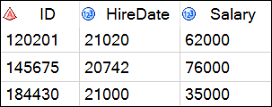
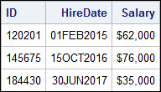
Formatting Data Values in Results
data
report
$w.
w.d
Changing how values appear makes it easier to interpret them.
Notes:
Sometimes when you're exploring data, it can be difficult to interpret the raw values in the data. For example, it's impossible to visually evaluate SAS date values such as HireDate in their raw form, so in your report, you might want to display the value in a date format that is easy to understand. Numeric columns such as Salary store only digits and decimal points, but we might want to display those numbers with commas or currency symbols to make them easier to interpret quickly.

Slide 44
Formatting Data Values in Results
PROC PRINT DATA=input-table;
FORMAT col-name(s) format;
RUN;
the number of decimal places for numeric formats
<$>format-name<w>.<d>
indicates a character format
total width of the formatted value
All formats include a period.
Notes:
To control how values appear in your reports, you can apply SAS formats to columns by adding the FORMAT statement to your PROC PRINT step. You use the keyword FORMAT, followed by the column and the SAS format that you want to apply to the column.
You specify the format using this general syntax. The dollar sign indicates a character format and precedes the name of the SAS format. Then you specify the total format width, including decimal places and special characters. The period is a required delimiter, and for numeric formats, it can be followed by the number of decimal places.

Slide 45
Common Formats for Numeric Values
Format Name | Example Value | Format Applied | Formatted Value
w.d | 12345.67 | 5. | 12346
w.d | 12345.67 | 8.1 | 12345.7
COMMAw.d | 12345.67 | COMMA8.1 | 12,345.7
DOLLARw.d | 12345.67 | DOLLAR10.2 | $12,345.67
DOLLARw.d | 12345.67 | DOLLAR10. | $12,346
YENw.d | 12345.67 | YEN7. | ¥12,346
EUROXw.d | 12345.67 | EUROX10.2 | €12.345,67
Notes:
SAS has dozens of formats you can use. Let's look at some of the most common formats and see the effect they have on the numeric value.
The w.d format specifies the width and number of decimal place. The 5. format applied here is the same as 5.0, so no decimal places are displayed. SAS rounds the displayed value to the nearest integer. By applying the 8.1 format, the value is displayed rounded to one decimal place. It's okay that the format width is 8, even though the digits and decimal point fill only seven positions.
The COMMA format inserts a comma. Specifying a width of 8.1 rounds the value to the nearest tenth. The DOLLAR format inserts a dollar sign in the displayed value. Keep in mind that the width must accommodate the total width of the displayed value, including the dollar sign, commas, decimal point, and decimal places. If you specify DOLLAR 10.2, the entire value is displayed. If we just use DOLLAR10., the formatted value is rounded to the nearest dollar. Similarly, the YEN format rounds to the nearest whole number and adds the Yen symbol. Lastly, in the EUROX format, a euro symbol is inserted in the displayed value, and decimal points and commas are transposed. Specifying EUROX10.2 formats the entire value. Please be aware that these international formats just add the symbol to the values. The formats do not convert values from one currency to another.

Slide 46
3.04 Activity
Go to support.sas.com/documentation. Click Programming: SAS 9.4 and Viya.
In the Syntax - Quick Links section, under Language Elements, select Formats.
What does the Zw.d format do?
Notes:
Type answer here

Slide 47
3.04 Activity – Correct Answer
Go to support.sas.com/documentation. Click Programming: SAS 9.4 and Viya.
In the Syntax - Quick Links section, under Language Elements, select Formats.
What does the Zw.d format do?
The format displays standard numeric data with leading zeros.
Z8.
1350
00001350
Notes:
Type answer here

Slide 48
Common Formats for Date Values
Value | Format | Formatted Value
21199 | DATE7. | 15JAN18
21199 | DATE9. | 15JAN2018
21199 | MMDDYY10. | 01/15/2018
21199 | DDMMYY8. | 15/01/18
21199 | MONYY7. | JAN2018
21199 | MONNAME. | January
21199 | WEEKDATE. | Monday, January 15, 2018
Notes:
SAS also offers a large variety of date formats. Although numeric SAS date values are perfect for calculations, we probably never want to look at those raw date values in our results. Here are a few examples of the same date value formatted with different date formats. Notice in the two DATE format examples that you can control the display of a two- or four-digit year by adjusting the width.

Slide 49
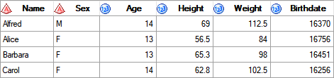
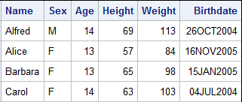
Formatting Multiple Columns
proc print data=pg1.class_birthdate;
format Height Weight 3. Birthdate date9.;
run;
p103d04
Notes:
Let's look at a code example. Here we are printing class_birthdate. You can format several columns using either the same format or different formats in a single FORMAT statement. Here we are formatting the columns height and weight with 3., which rounds the value to the nearest whole number, and we are formatting Birthdate with the DATE9. format. These formats impact the way the values are displayed in the procedure results, but they do not change the raw data values themselves.

Slide 50
Formatting Data Values in Results
This demonstration illustrates using the FORMAT statement in a procedure to display data values as dates and currency.
p103d04
Notes:
So let’s take a look at our storm_damage table. I’ll start with a PROC PRINT step to list the data as-is. I would like Damage to be displayed with dollar signs and commas, and Date I would like to see as month/day/year (4 digits). I will add the FORMAT statement to PROC PRINT and list the column name Damage, followed by the format I would like to apply – dollar. I need a width of at least 16 to display all of the digits, commas and dollar sign for each value, so I will type 16. (dot). I don’t want to display any decimal places, so I don’t need to provide a number after the dot. Continuing on the same FORMAT statement, I’ll type the second column, Date, and the format, mmddyy10. After running the program, we see the report now displays our formatted values.
proc print data=pg1.storm_damage;
format damage dollar16. date mmddyy10.;
run;
What happens if we provide a width that is smaller than the data values? Let’s try it out. I’ll change the width on the DOLLAR format to 14, and MMDDYY to 8. Notice the larger Damage values no longer have commas, and Date now displays only a 2 digit year. Let’s go one step further and try DOLLAR12. and MMDDYY6. Now the dollar sign is gone for all Damage values, and some now display as scientific notation. Date no longer includes slashes to delimit month, day and year.

Slide 51
3.05 Activity
Open p103a05.sas from the activities folder and perform the following tasks:
Highlight the PROC PRINT step and run the selected code. Notice how the values of Lat, Lon, StartDate, and EndDate are displayed in the report.
Change the width of the DATE format to 7 and run the PROC PRINT step. How does the display of StartDate and EndDate change?
Change the width of the DATE format to 11 and run the PROC PRINT step. How does the display of StartDate and EndDate change?
Highlight the PROC FREQ step and run the selected code. Notice that the report includes the number of storms for each StartDate.
Add a FORMAT statement to apply the MONNAME. format to StartDate and run the PROC FREQ step. How many rows are in the report?
Notes:
Notice frequency counts are now based on quarter number, the formatted values of StartDate, and the results are ordered by the formatted values of StartDate.

Slide 52
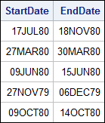
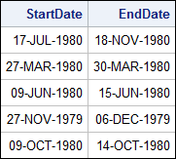
3.05 Activity – Correct Answer
continued...
Change the width of the DATE format to 7 and run the PROC PRINT step. How does the display of StartDate and EndDate change?
Change the width of the DATE format to 11 and run the PROC PRINT step. How does the display of StartDate and EndDate change?
DATE7. displays a two-digit year.
DATE11. displays a four-digit
year and adds dashes.
Notes:
Type answer here

Slide 53
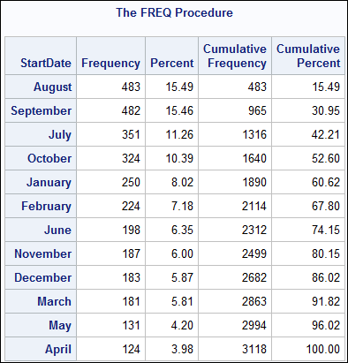
3.05 Activity – Correct Answer
Add a FORMAT statement to apply the MONNAME. format to StartDate and run the PROC FREQ step. How many rows are in the report?
proc freq data=pg1.storm_summary order=freq;
tables StartDate;
format startdate monname.;
run;
Formats are an easy way to group data in procedures!
The new report has 12 rows.
Notes:
Type answer here

Slide 54
Lesson 3: Exploring and Validating Data
3.1 Exploring Data
3.2 Filtering Rows
3.3 Formatting Columns
3.4 Sorting Data and Removing Duplicates

Slide 55
Sorting Data
improve visual arrangement of the data
identify and remove duplicate rows
prepare data for certain data processing steps
Notes:
Sorting data can be a helpful or necessary step in exploring your data. You might want to sort on groups or measures so that you can visually examine the high or low values. You might use sorting as a way to identify and remove duplicate rows. Also, sorting might be required for certain data processing steps.

Slide 56
Sorting Data
PROC SORT DATA=input-table <OUT=output-table>;
BY <DESCENDING> col-name(s);
RUN;
overrides the default ascending sort order
columns (character, numeric, or both) to sort by
If you don't use the OUT= option, SAS overwrites the input table.
Notes:
To sort the rows in a table, you use the SORT procedure. Using PROC SORT, you can sort on one or more character or numeric columns.
So how does it work? First, SAS rearranges the rows in the input table. Then SAS creates a table that contains the rearranged rows either by replacing the original table or by creating a new table. By default, SAS replaces the original SAS table unless you use the OUT= option to specify an output table. Keep in mind that PROC SORT does not generate printed output, so you have to open or print the sorted table if you want to look at it.
Let’s check out the basic syntax. Similar to PROC PRINT and other procedures, you use the DATA= option to specify the input table. Next, we often use the OUT= option in the PROC SORT statement so we don't permanently sort the input table. If you don’t include the OUT= option, PROC SORT changes the sort order of the input table.
Every PROC SORT step must include a BY statement. The BY statement specifies one or more columns in the input table whose values are used to sort the rows. The BY statement also indicates whether you want to sort in ascending or descending order. By default, SAS sorts in ascending order, but if you want to sort by a column in descending order, you must specify the DESCENDING keyword immediately before each column that you want in descending order.

Slide 57
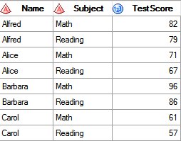
Sorting Data
proc sort data=pg1.class_test2 out=test_sort;
by Name;
run;
ascending order by Name
Notes:
In this BY statement, we sorting the data by ascending values of Name.

Slide 58
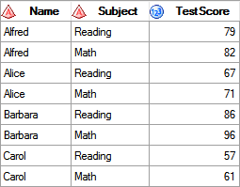
Sorting Data
proc sort data=pg1.class_test2 out=test_sort;
by Name TestScore;
run;
ascending order by Name and then within Name by ascending TestScore
Notes:
This BY statement sorts first by ascending values of Name, and then within Name by ascending values of TestScore.

Slide 59
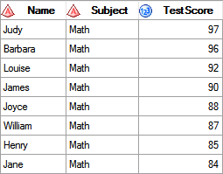
Sorting Data
proc sort data=pg1.class_test2 out=test_sort;
by Subject descending TestScore;
run;
ascending order by Subject and then within Subject by descending TestScore
Notes:
And finally this BY statement sorts by ascending values of Subject, and then within Subject by descending values of TestScore.

Slide 60
3.06 Activity
Open p103a06.sas from the activities folder and perform the following tasks:
Modify the OUT= option in the PROC SORT statement to create a temporary table named storm_sort.
Complete the WHERE and BY statements to answer the following question: Which storm in the North Atlantic basin (NA or na) had the strongest MaxWindMPH?
PROC SORT DATA=input-table <OUT=output-table>;
WHERE expression;
BY <DESCENDING> col-name(s);
RUN;
Notes:
Type answer here

Slide 61
3.06 Activity – Correct Answer
Open p103a06.sas from the activities folder and perform the following tasks:
Modify the OUT= option in the PROC SORT statement to create a temporary table named storm_sort.
Complete the WHERE and BY statements to answer the following question: Which storm in the North Atlantic Basin (NA or na) had the strongest MaxWindMPH? Allen
Allen, 190
proc sort data=pg1.storm_summary out=storm_sort;
where Basin in("NA" "na");
by descending MaxWindMPH;
run;
Notes:
Type answer here

Slide 62
Identifying and Removing Duplicate Rows
PROC SORT DATA=input-table <OUT=output-table>
NODUPKEY <DUPOUT=output-table>;
BY _ALL_;
RUN;
output table of duplicates
sorts by all columns to ensure that duplicate rows are adjacent
removes adjacent rows with duplicate BY values
Notes:
The SORT procedure provides an easy way to identify and remove duplicates in your data. In the PROC SORT statement, The NODUPKEY option checks for and eliminates observations with duplicate BY variable values. If you would like to remove entirely duplicated rows, then you need to sort by all columns. This can be easily accomplished by using the keyword _ALL_ in the BY statement instead of a list of column names. It's also helpful for validation to specify the DUPOUT= option and generate a table of the duplicate rows that were removed by NODUPRECS.

Slide 63
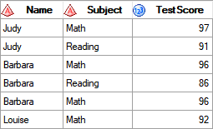
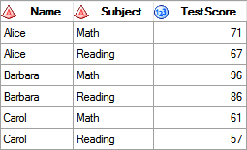

Identifying and Removing Duplicate Rows
proc sort data=pg1.class_test3 out=test_clean
nodupkey
dupout=test_dups;
by _all_;
run;
pg1.class_test3
test_clean
test_dups
Notes:
Here's an example of using the NODUPRECS option. You can see that there are two rows for Barbara that contain identical information.

Slide 64
Identifying and Removing Duplicate Key Values
PROC SORT DATA=input-table <OUT=output-table>
NODUPKEY <DUPOUT=output-table>;
BY <DESCENDING> col-name(s);
RUN;
This removes duplicate values of the column listed in the BY statement.
keeps only the first occurrence of each unique value of the BY variable
Notes:
Another option that's available is NODUPKEY. This option is helpful when you want to identify whether you have duplicated values for select columns. When you add the NODUPKEY option to the PROC SORT statement, only the first occurrence for each unique value of the column listed in the BY statement is kept in the output table. Let's see how this works in an example.

Slide 65
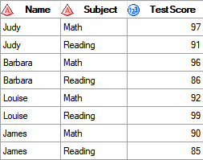
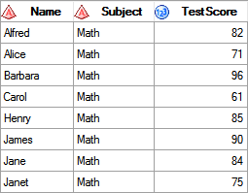
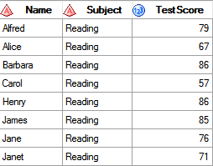
Identifying and Removing Duplicate Key Values
proc sort data=pg1.class_test2
out=test_clean
dupout=test_dups
nodupkey;
by Name;
run;
pg1.class_test2
test_clean
test_dups
Notes:
In this example, we keep only the first row for each unique value of Name in class_test2. Because the math test was listed first for each student in the data, the output table test_clean has all the math test information, and the test_dups table has the reading test information.

Slide 66
Identifying and Removing Duplicate Values
This demonstration illustrates using the NODUPKEY option in PROC SORT to identify and remove duplicates.
p103d05

Slide 67
Beyond SAS Programming 1
What if you want to ...
. . . discover other procedures for exploring your data?
. . . dive deeper into the SAS macro language?
. . . create custom formats based on your data?
Visit the SAS 9.4 Procedures Help page.
Browse or ask questions in the SAS Procedures community and see responses from other SAS programmers.
Take the SAS Macro 1 course.
Read the SAS Macro Programming Made Easy book.
Learn about PROC FORMAT in SAS Help.
Take the SAS Programming 2 course.

Slide 68
Practice
This practice reinforces the concepts discussed previously.

Slide 69
Lesson Quiz

Slide 70
Which of the following is a valid name for a character format?
country
$ctry
$country.
_country

Slide 71
Which of the following is a valid name for a character format?
country
$ctry
$country.
_country
Notes:
b)
Character formats must start with a dollar sign followed by a letter or underscore. A format name does not end with a period. The period is a required delimiter when using a format in a FORMAT statement.

Slide 72
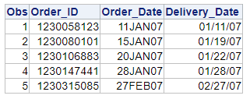
Which of the following FORMAT statements was used to create this output?
format Order_Date date9. Delivery_Date mmddyy8.;
format Order_Date date7. Delivery_Date mmddyy8.;
format Order_Date ddmmmyy. Delivery_Date mmddyy8.;
format Order_Date monyy7. Delivery_Date mmddyy8.;

Slide 73
Which of the following FORMAT statements was used to create this output?
format Order_Date date9. Delivery_Date mmddyy8.;
format Order_Date date7. Delivery_Date mmddyy8.;
format Order_Date ddmmmyy. Delivery_Date mmddyy8.;
format Order_Date monyy7. Delivery_Date mmddyy8.;
Notes:
b) The DATE7. format displays a two-digit day, three-letter month abbreviation, and two-digit year. The MMDDYY8. format displays a two-digit month, day, and year, separated by slashes.

Slide 74
The format name must include a period delimiter in the FORMAT statement.
True
False

Slide 75
The format name must include a period delimiter in the FORMAT statement.
True
False
Notes:
a)
The period is a required syntax element in a format name within a FORMAT statement.

Slide 76

Which row or rows are selected by the following WHERE statement?
row 1
row 2
row 3
rows 1 and 2
all rows
where Job_Title like "Sales%";

Slide 77
Which row or rows are selected by the following WHERE statement?
row 1
row 2
row 3
rows 1 and 2
all rows
where Job_Title like "Sales%";
Notes:
d)
This WHERE statement returns rows that contain Sales with any number of additional characters after "Sales" because of the position of the percent sign.

Slide 78
Which statement about this PROC SORT step is true?
The sorted table overwrites the input table.
The rows are sorted by Salary in descending order, and then by Manager_ID in descending order.
A semicolon should not appear after the input table name.
The sorted table contains only the columns specified in the BY statement.
proc sort data=orion.staff;
out=work.staff;
by descending Salary Manager_ID;
run;

Slide 79
Which statement about this PROC SORT step is true?
The sorted table overwrites the input table.
The rows are sorted by Salary in descending order, and then by Manager_ID in descending order.
A semicolon should not appear after the input table name.
The sorted table contains only the columns specified in the BY statement.
proc sort data=orion.staff;
out=work.staff;
by descending Salary Manager_ID;
run;
Notes:
c)
This PROC SORT step has a syntax error: a semicolon in the middle of the PROC SORT statement. If you correct this syntax error, this step sorts orion.staff by Salary in descending order and by Manager_ID in ascending order. The step then creates the temporary data set staff that contains the sorted rows and all columns.

Slide 80
Which of the following statements selects from a table only those rows where the value of the Style column is RANCH, SPLIT, or TWOSTORY?
where Style='RANCH' or 'SPLIT' or 'TWOSTORY';
where Style in 'RANCH' or 'SPLIT' or 'TWOSTORY';
where Style in (RANCH, SPLIT, TWOSTORY);
where Style in ('RANCH', 'SPLIT', 'TWOSTORY');

Slide 81
Which of the following statements selects from a table only those rows where the value of the Style column is RANCH, SPLIT, or TWOSTORY?
where Style='RANCH' or 'SPLIT' or 'TWOSTORY';
where Style in 'RANCH' or 'SPLIT' or 'TWOSTORY';
where Style in (RANCH, SPLIT, TWOSTORY);
where Style in ('RANCH', 'SPLIT', 'TWOSTORY');
Notes:
d)
In the WHERE statement, the IN operator enables you to select rows based on several values. You specify values in parentheses and separate them with spaces or commas. Character values must be enclosed in quotation marks and must be in the same case as in the data set.

Slide 82
Which of the following statements selects rows in which Amount is less than or equal to $5,000 or Rate equals 0.095?
where amount <= 5000 or rate=0.095;
where amount le 5000 or rate=0.095;
where amount <= 5000 or rate eq 0.095;
all of the above

Slide 83
Which of the following statements selects rows in which Amount is less than or equal to $5,000 or Rate equals 0.095?
where amount <= 5000 or rate=0.095;
where amount le 5000 or rate=0.095;
where amount <= 5000 or rate eq 0.095;
all of the above
Notes:
d)
All of the statements shown here select rows in which Amount is less than or equal to $5000 or Rate equals 0.095.

Slide 84
Which statement creates the macro variable flower and assigns the value Plumeria?
%let flower=Plumeria;
%let flower="Plumeria";
%let &flower=Plumeria;
%let &flower="Plumeria";

Slide 85
Which statement creates the macro variable flower and assigns the value Plumeria?
%let flower=Plumeria;
%let flower="Plumeria";
%let &flower=Plumeria;
%let &flower="Plumeria";
Notes:
a)
In the %LET statement, the name of the macro variable is followed by an equal sign and the unquoted value. The ampersand is added when you use the macro variable.

Slide 86
Which statement in a PROC MEANS step enables you to specify the numeric columns to analyze?
TABLES
VARS
VAR
KEEP=

Slide 87
Which statement in a PROC MEANS step enables you to specify the numeric columns to analyze?
TABLES
VARS
VAR
KEEP=
Notes:
c) You use the VAR statement to specify the numeric columns to analyze in PROC MEANS. If you don't specify the VAR statement, all numeric columns are analyzed.

Slide 88
If you have a table that includes flower sales to all your retail outlets. You want to see the distinct values of Flower_Type with a count and percentage for each. Which procedure would you use?
PRINT
MEANS
UNIVARIATE
FREQ

Slide 89
If you have a table that includes flower sales to all your retail outlets. You want to see the distinct values of Flower_Type with a count and percentage for each. Which procedure would you use?
PRINT
MEANS
UNIVARIATE
FREQ
Notes:
d) PROC FREQ output includes the distinct values for the column and a frequency count, percent, and cumulative frequency and percent.

